Slide 1
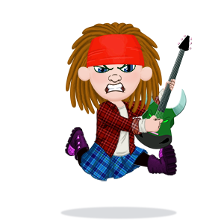
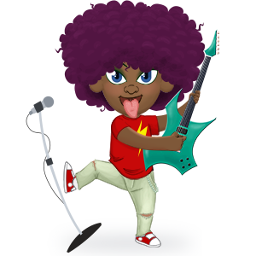
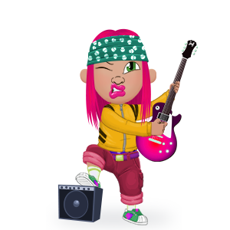

Slide 2




Why is it important to know your times tables off by heart?
@TTRockStars
ttrockstars.com

Slide 3
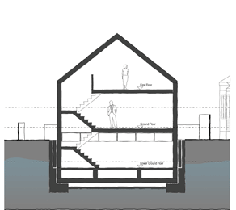
If maths was a house…
All the even more super fun stuff
Graphs, shapes & algebra
Fractions & %
× and ÷
+ and –
Counting
@TTRockStars
ttrockstars.com

Slide 4
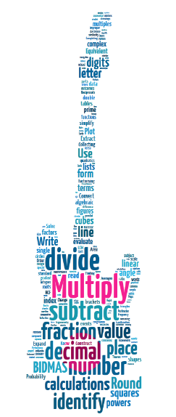
The times tables are the basics of maths. If you know the basics, you’ll find the rest much much easier.
@TTRockStars
ttrockstars.com
Notes:
This is saying largely what the previous slide but with a different image.
You might be interested to know that the word cloud was based on an analysis of GCSE topics by Will Emeny (Great Maths Teaching Ideas). The thing that came out on top (in terms of direct and indirect application in GCSE maths) was times tables. Nearly 60% of GCSE topics could be traced to a root in times tables.

Slide 5

OK, times tables are important but I find them hard to remember.
And not much fun to learn.
So what’s the plan?

Slide 6
Introducing…
@TTRockStars
ttrockstars.com

Slide 7

@TTRockStars
ttrockstars.com

Slide 8
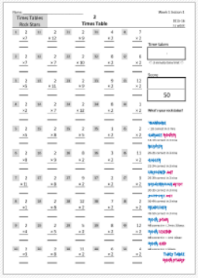
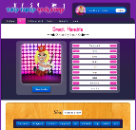
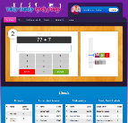
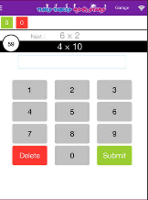
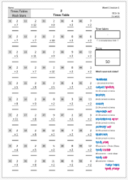
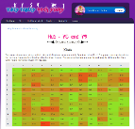
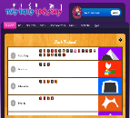

Three Modes
Lesson 1
Lesson 2
Lesson 3
Lesson 4
Lesson 5
Paper
Website
App
@TTRockStars
ttrockstars.com

Slide 9

Paper version
Lesson 1
Lesson 2
Lesson 3
Lesson 4
Lesson 5
Time 1
Score 1
Time 2
Score 2
+
Time 3
+
Score 3
Time 4
Score 4
Time 5
Score 5
 3 mins
 3 mins
Total Time
Total Score
 3 mins
 3 mins
 3 mins
@TTRockStars
ttrockstars.com

Slide 10

Total Time
Rock speed
(seconds per question)
÷
Total Score
@TTRockStars
ttrockstars.com

Slide 11
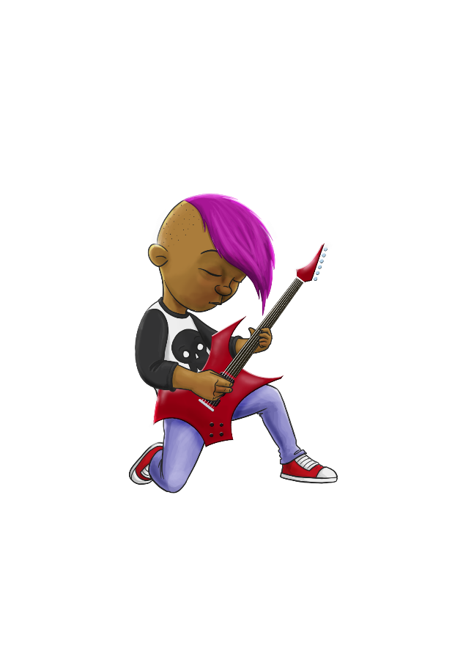
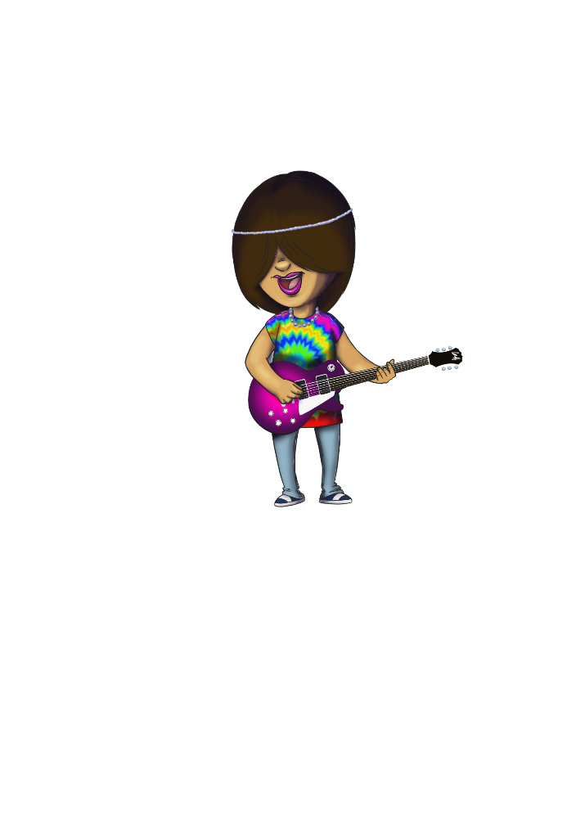
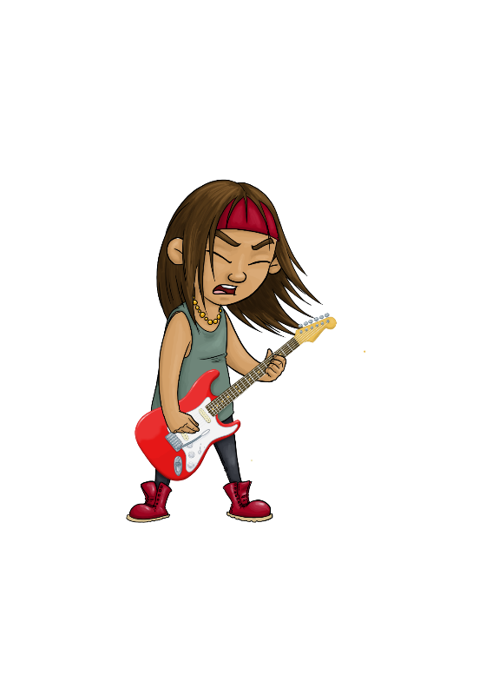
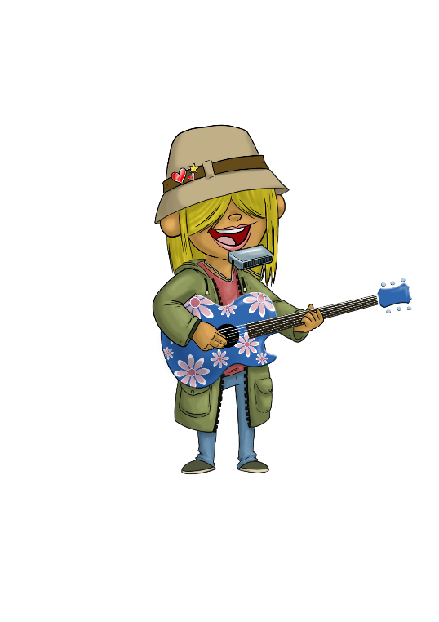
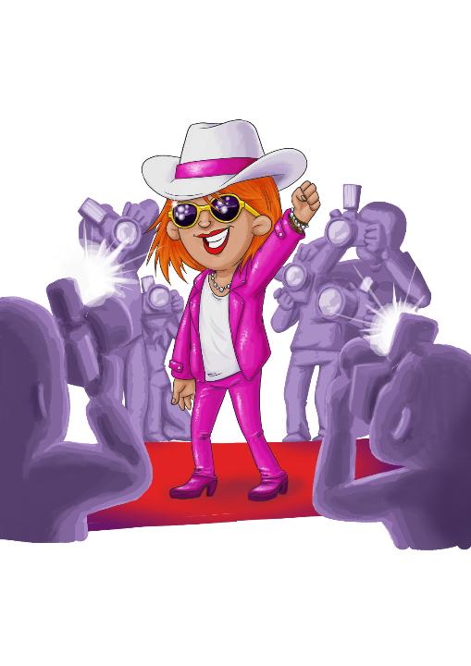

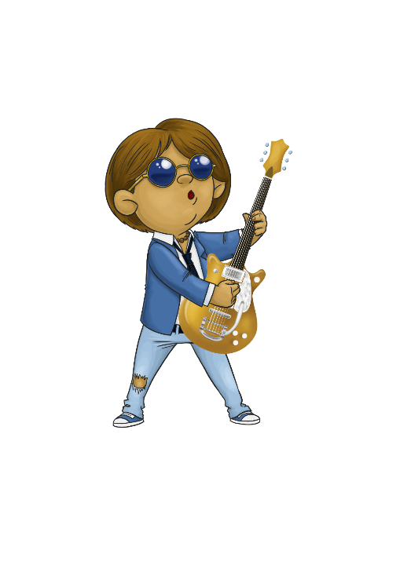
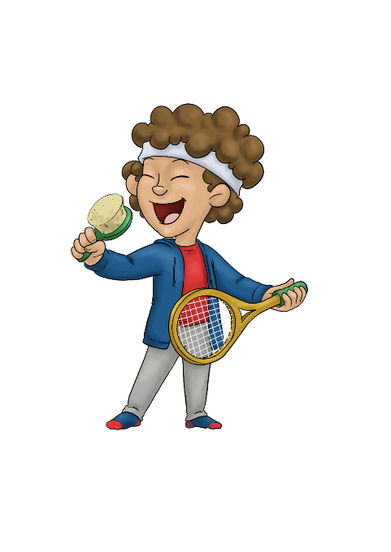
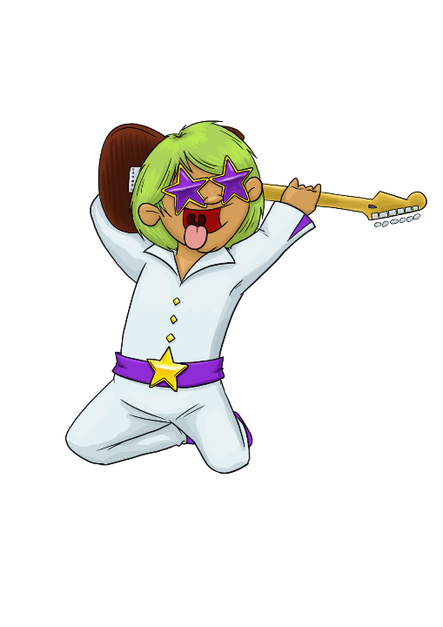
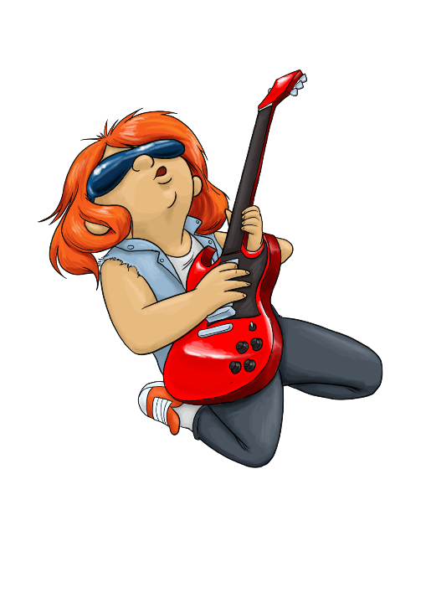

Rock speed
(seconds per question)
Rock Star
3 seconds/question
Rock Hero
one second
per question
Breakthrough Artist
6 seconds/question
Garage Rocker
10 seconds/question
Support Act
5 seconds/question
Busker
9 seconds/question
Unsigned Act
7 seconds/question
Rock Legend
2 seconds/question
Gigger
8 seconds/question
Wannabe
+10 seconds/question
Headliner
4 seconds/question
@TTRockStars
ttrockstars.com
Total Time
÷
Total Score

Slide 12



















Website
•
1 minute games
Single player
Or
Multi-player
Earn & spend on your avatar
@TTRockStars
ttrockstars.com

Slide 13













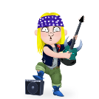

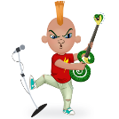

@TTRockStars
ttrockstars.com

Slide 14

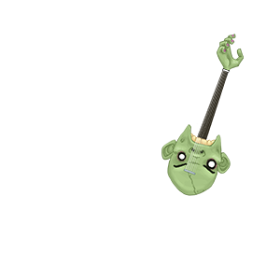
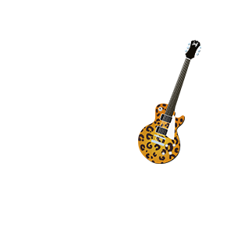
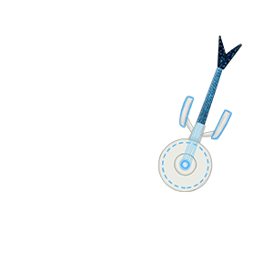
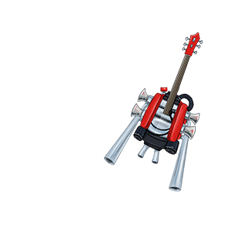
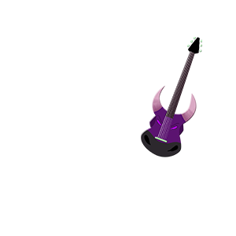
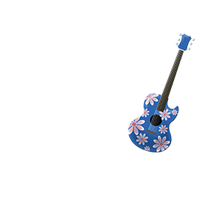
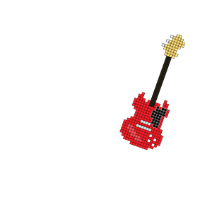

@TTRockStars
ttrockstars.com

Slide 15



App
Earn & spend on your avatar
Single player
Or
Multi-player
•
1 minute games
@TTRockStars
ttrockstars.com
Notes:
Show this slide instead of slide 17 if you’re going to be using the app rather than the website.
Remember, to use the app, your school must have the Mobile Apps bolt-on. Go to Subscription Details once you’ve logged in to find out if you have it enabled.

Slide 16
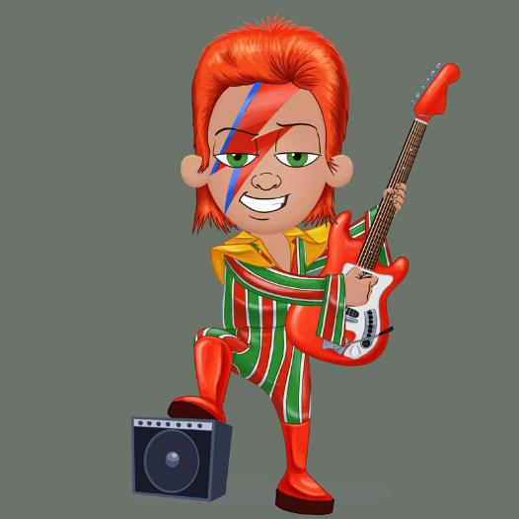
Knowing your times tables off by heart is like being able to play a guitar behind your head – it makes you a rock star... a
Times Table
Rock Star!
@TTRockStars
ttrockstars.com

Slide 17
The first National Multiplication Tests tooplace in June 2020 for Year 4. The children have only 5 seconds to work out the maths calculation and type it in.
@TTRockStars
ttrockstars.com

